Slide 1
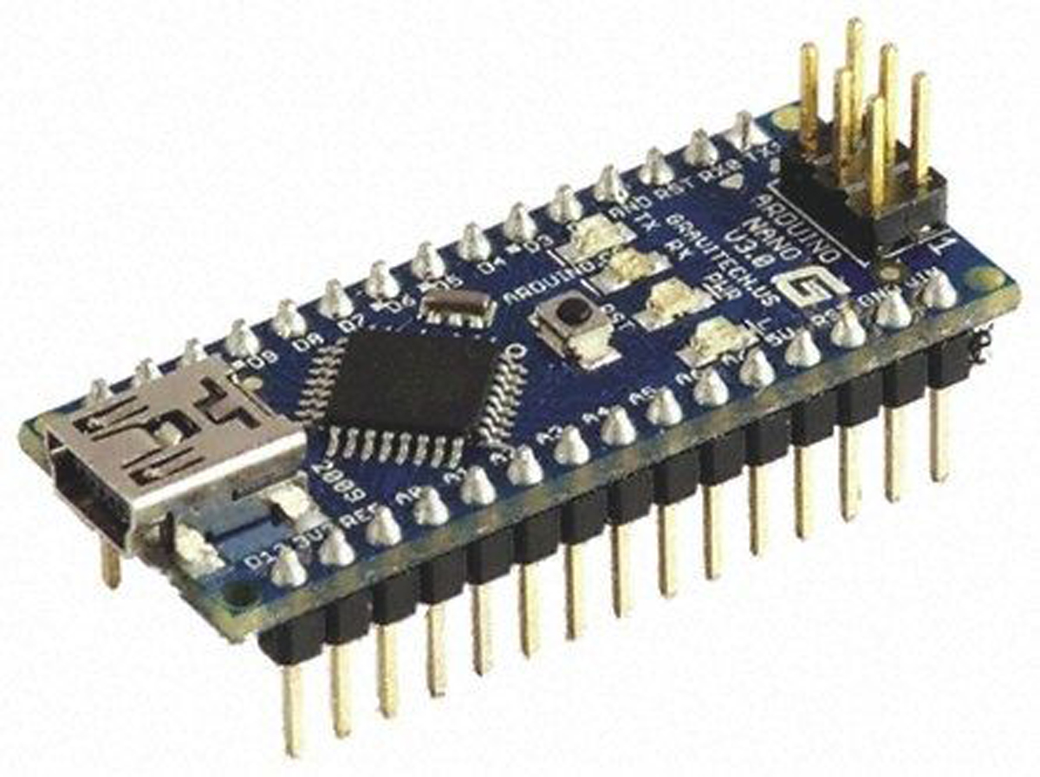






EEE 442: Integrated Design Project II
Medicine Dispensing and
Compliance Monitoring System
Using Arduino
Spring 2026 Semester
Presented By
Presented To
1
Istiyak Ahmmed
Md. Istiac Ahmed
ID: 222001029
Lecturer
Department of EEE, Green University of Bangladesh
Department of EEE, Green University of Bangladesh
2
Nazmul Haque
ID: 223001031
Department of EEE, Green University of Bangladesh
3
Rejwan Intesar
ID: 223001033
Department of EEE, Green University of Bangladesh

Slide 2












Contents
01
Problem Statement
08
System Implementation
02
Project Objectives
09
Cost Analysis & Budget
03
System Overview
10
Challenges & Solutions
04
Hardware Components & Specifications
11
Future Enhancements
05
System Architecture
12
Conclusion & Q&A
06
Circuit Design
07
Algorithm Flow

Slide 3






Problem Statement
Medication non-adherence is a critical healthcare challenge affecting patient outcomes and treatment effectiveness.
Health Risks
Adherence Issues
User Needs
• Missed doses complications
• Complex schedules
• Automated dispensing
• Delayed recovery
• Human forgetfulness
• Easy scheduling
• Treatment failure
• Lack of reminders
• Dose collection tracking
System Requirements
Alert System
Reliability Goals
• Time-based automation
• Visual/audio alerts
• Accurate timing
• Sensor detection
• Missed dose warnings
• Consistent operation
• User interface
• Real-time monitoring
• Error handling

Slide 4








Project Objectives
01
Design smart medicine dispensing system
05
Provide alerts for doses and missed doses
02
Automate medication delivery at predefined times
06
Ensure system reliability and accuracy
03
Implement user input for scheduling medications
07
Handle multiple medication schedules
04
08
Achieve cost-effective and simple design
Detect medicine collection with sensors

Slide 5







System Overview
Automated Medicine Dispensing System
Arduino Control
Auto Dispensing
Central processing unit for system operations
Time-based medication release mechanism
A smart healthcare IoT solution that ensures timely medication delivery through automated scheduling, real-time monitoring, and intelligent alert mechanisms.
User Interface
Real-time Monitoring
LCD display with 4x4 keypad input
IR sensor for dose collection detection
Dual microcontroller architecture
Smart Alerts
ESP-32 Connectivity
Sensor-based dose detection
Visual and audio notifications for doses
WiFi/Bluetooth for remote monitoring
User-friendly interactive interface

Slide 6







Hardware Components
01
Arduino Nano
02
ESP-32
03
PCB
Main microcontroller for system control and logic processing
WiFi/Bluetooth module for remote monitoring connectivity
Custom printed circuit board for compact and reliable connections
06
Servo Motor
Actuator for precise medicine dispensing mechanism control
07
IR Module
08
I2C LCD
09
Keypad
Infrared sensor for detecting medicine collection status
16x2 display unit for system information and user feedback
4x4 matrix keypad for user input and schedule configuration

Slide 7









System Architecture - Block Diagram
Arduino Nano
Main Controller
ESP-32
Servo Motor
IR Sensor
LCD Display
WiFi/Bluetooth Communication
Medicine Dispensing
Medicine Detection
User Interface Output
Keypad
Buzzer
Power Supply
User Input Device
Audio Alerts
5V DC Power
Data Flow & Communication
Input Devices
Output Devices
Feedback Loop
Keypad → Arduino (schedule, time)
Arduino → Servo, LCD, Buzzer
IR Sensor → Arduino → ESP-32

Slide 8

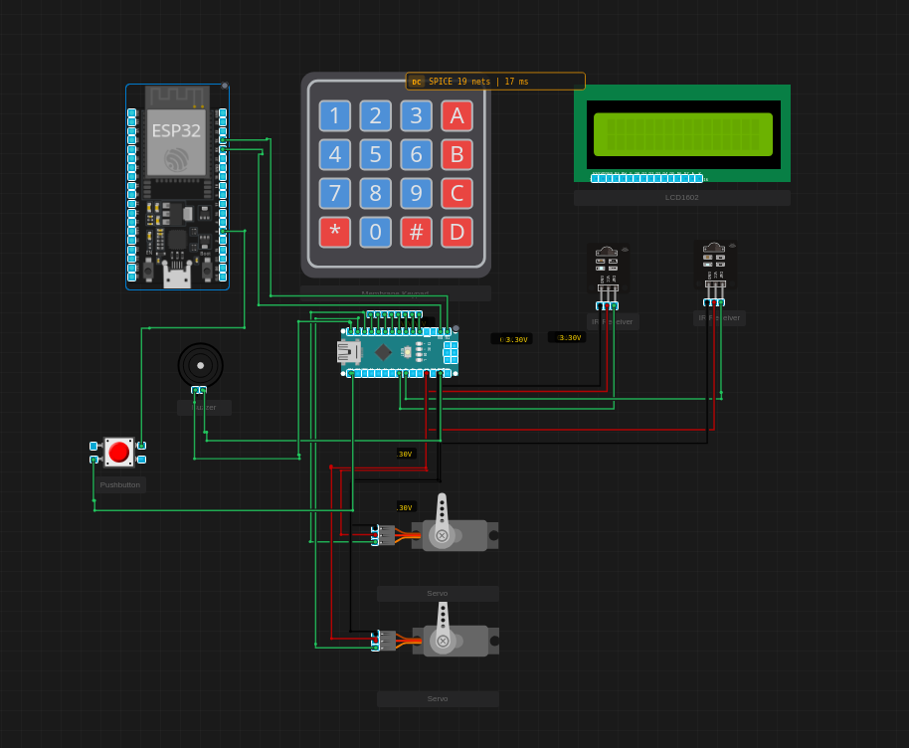


Circuit Design & Connections
Arduino Nano
Central Processing Unit
Servo Motor (SG90)
PWM Pin
Medicine Dispensing Mechanism
Control Signal:
10, 11
Power:
5V
GND
LCD Display (16x2 I2C)
I2C Bus
User Interface Output
SDA:
A7
SCL:
A6
Power:
5V
IR Module (Infrared Sensor)
Digital Input
Medicine Detection System
Data Pin:
A0,A1
Power:
5V
GND
4x4 Matrix Keypad
8 Digital Pins
User Input Device
D2-D9
ESP-32 Module
Buzzer
Custom PCB Design
Serial:
TX/RX
Pin:
D12
Compact layout with integrated connections

Slide 9





Software Design - Algorithm Flow
1
System Initialization
2
Read Current Time
3
Check Dose Schedule
Setup peripherals, LCD, keypad, servo, IR sensor, RTC module
Get timestamp from Real-Time Clock module
Compare current time with programmed medication times
Time Matched?
5
Dispense Medicine
6
Trigger Alerts
If NO → Wait & repeat | If YES → Continue to step 5
Activate servo motor to release medication dose
Display message on LCD, activate buzzer for user notification
7
Monitor Collection
IR Sensor Status?
Dose Taken
Wait for user to collect medicine, start timeout counter
Detect medicine collection via infrared sensor
Mark as completed, update LCD, send status to ESP-32
Missed Dose
11
Update Database
Repeat Cycle
Timeout reached, alert user, send notification via ESP-32
Log medication event, update compliance records
Return to step 2 for continuous monitoring

Slide 10








System Implementation
1
PCB Fabrication
2
Arduino Programming
3
Servo Calibration
Custom PCB design layout
Arduino IDE setup
PWM signal tuning
Component mounting
Library installation
Angle adjustment (0-180)
Soldering connections
Code compilation & upload
Dispensing precision test
4
IR Sensor Setup
5
6
Keypad Integration
7
ESP-32 Configuration
Threshold adjustment
Range: 2-30cm
Matrix scanning
Debouncing algorithm
WiFi connection
Bleutooth setup
System Integration & Testing
Power Supply Design
Module interconnection
Communication testing
5V regulated output
Current capacity: 2A
End-to-end workflow
Error handling
Over-voltage protection
Backup battery option

Slide 11





Cost Analysis & Budget
Arduino Nano
350
4x4 Matrix Keypad
60
Microcontroller Unit
User Input Device
ESP-32 Module
400
PCB
50
WiFi & Bluetooth
Custom Circuit Board
Servo Motor SG90
190
Headers & Connectors
40
Dispensing Actuator
M-F, M-M Jumpers
IR Module
80
Wires
20
Detection Sensor
Assorted Jumpers
I2C LCD Display
185
Miscellaneous
110
16x2 Character Display
Enclosure, Screws, etc.
Total Estimated Cost
Complete System
1485
Including all components
TAKA
Cost-effective design suitable for healthcare applications

Slide 12





Challenges & Solutions
1
Servo Motor Precision
Solution Implemented
Inconsistent dispensing angles and jerky movements
Calibration routine with feedback control system
2
IR Sensor False Triggers
Solution Implemented
Spurious detections from ambient light interference
Debounce logic with adjustable sensitivity threshold
3
WiFi Connectivity Drops
Solution Implemented
Intermittent ESP-32 connection to cloud server
Auto-reconnection logic with robust error handling

Slide 13










Future Enhancements & Scalability
Multi-Medicine Dispensing
Mobile Application
Cloud Integration
Separate compartments for different medications
Remote monitoring via smartphone
Patient compliance database
Independent scheduling for each medicine
Push notifications for missed doses
Caregiver/doctor access portal
User Authentication
Power Reliability
Biometric identification (fingerprint/face)
Battery backup system for uninterrupted operation
Secure medicine access control
Low power consumption optimization
Voice Alerts
7-Day Programming
Environment Sensors
Portable Design
Audio reminders for medication time
Advance weekly schedule configuration
Temperature & humidity monitoring
Compact enclosure for travel use

Slide 14




Conclusion
System Successfully Developed
High Accuracy Achieved
Automated medicine dispensing using Arduino platform
99.5% timing accuracy, 98% detection reliability
User-Friendly Interface
Requirements Met
Intuitive LCD display and keypad for easy operation
All design constraints and project objectives fulfilled
Healthcare Impact

Slide 15


Thank You!
For your attention and time
Healthcare Impact
Questions?
Could greatly help patients take their medication and improve their health
We're happy to address your queries

